Slide 1

Evaluation of Rust language for Embedded Systems in terms of Security, Usability and Performance.
Ankita Kumari ge93vep@mytum.de Advisor: Andreas Finkenzeller Department of Electrical and Computer Engineering
Technical University of Munich

Slide 2
Contents
Motivation
Introduction to Rust
Memory Exploits in Rust
Invasive and Non Invasive attacks in Rust
Performance Evaluation of Rust vs C
Discussion
Conclusion

Slide 3

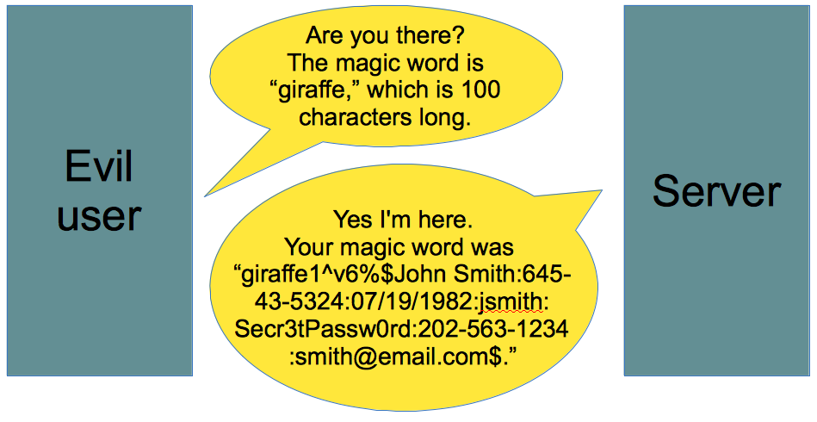
Motivation
C for Embedded Systems
Portability
Control over resources
Efficient Code
From Smashing the Stack for Fun and Profit[1] to Heartbleed Vulnerability [2].
Memory exploits in C
Pointer manipulation
No bound checking
Security up to the programmer
The Heartbleed Vulnerability [2]
Example of Buffer overread [3]

Slide 4
Motivation
Defense mechanism
Address Space Layout Randomisation
Data Execution Prevention
Secure Coding
Not used mostly, performance overhead
Memory Exploits remains most dangerous vulnerabilities (CWE [4])
Other secure languages
Portable but not map to assembler & has Garbage Collection (Java)
Safe but bad cross-compiling (Google Go)

Slide 5
Aim
Rust [5]
Memory Safety
Strong compile-time checks
The presentation would mainly focus on the security aspects of Embedded Systems with Rust.
Security provided by Rust
Performance of Rust compared to C
Compatibility of Rust with libraries written in C

Slide 6
Introduction to Rust
Works for embedded programming:
Produces predictable assembly
Interoperability with C
No garbage collection
Provides security features including memory safety, type safety, and error handling.
Ownership | Every Value in Rust has a single owner at a given time
Borrowing | Used to pass the reference but keep the ownership
Mutability | Immutable by default. Makes sharing of data easier. Prevents overwriting
Lifetime | A variable only lives in its defined scope

Slide 7
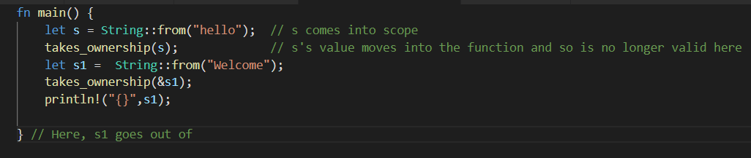
Ownership, Borrowing and Lifetime
Memory Safety Data Race Freedom

Slide 8
Security vulnerabilities in Embedded System
Vulnerabilities
Software Attacks
Hardware Attack
Buffer Over/Under Flow
Pointer Errors
Invasive Attacks
Non-Invasive Attacks

Slide 9
Software Vulnerabilities
Software attacks are carried out on the system by executing a piece of code to take control of the device
Buffer Overflow Attacks
Double Free
Use after free
Null Pointer

Slide 10
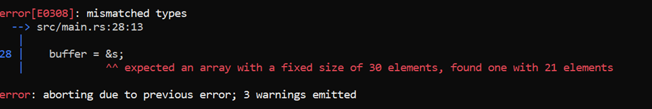
Trying Buffer Overflow Using Rust
let mut a: [char; 2] = ['1', '2'];
let b: [char; 3] = ['1', '2', '3'];
a.copy_from_slice(&b);
Rust panics. Usually the panic function, terminate the program.
let buffer : [u8;30];
let s: [u8;21];

Slide 11
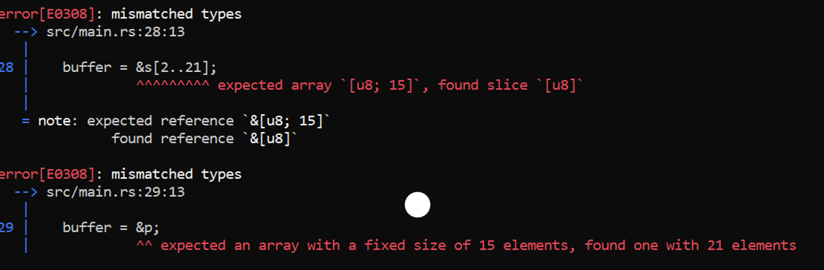
Buffer Overflow Cont.
let p = s;

Slide 12
Heartbleed Vulnerability in Rust
If payload size larger than the buffer pl, additional data was copied to the buffer bp.
3+payload is the upper index of the slice to be copied.
Rust will panic if tried to access out of bound value from p
memcpy(bp, pl, payload);
let payload:usize = ((p[1] as usize) << 8) + p[2] as usize; //p is the user input string
let mut bp: [u8;payload+PADDING]; //needs constant size of array
bp.extend(p[3..3+payload].iter().cloned()); //copy of payload string happens here.

Slide 13
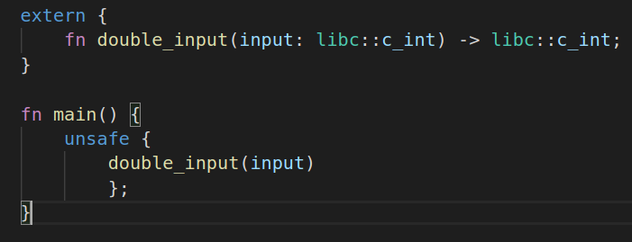
Unsafe Keyword
Allows to call functions from other languages
Use unsafe to develop some functions that cannot pass the compiler’s default inspection.
Allowing the code to interact with system/hardware components directly.
Unsafe Keyword

Slide 14
Memory Exploits Using Unsafe Keywords
Raw Pointer dereferencing
unsafe allows dereferencing the pointer even when it is freed
Null pointer is undefined in Rust
let p;
{
let mut x: u8 = 1;
p = x as *const i32;;
} // x goes out of scope here
let c = p;
unsafe{
hprintln!("{}",*p);
}
let k = 0usize;
unsafe {
let l = k as *const i32;
hprintln!("{}", *l);
}

Slide 15
Buffer Overread
let mut a: [u8; 3] = [2,3,4];
let prt: *mut [u8;3] = &mut a;
let big_ptr: *mut [u8;20] = prt as *mut [u8;20];
unsafe {
let mut new_array: [u8;20] = *big_ptr;
new_array[10] = 10;
}
new_array is located past the length of array a in the memory.
*big_ptr copy the contents of big_ptr to the new_array. So there is an overread by reading the memory past the length of a
Exploited if memory after array a contain some secret, the attacker could retrieve it.

Slide 16
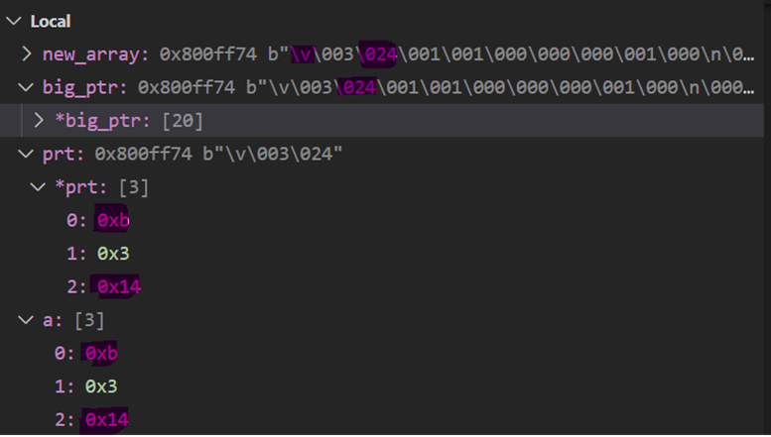
Immutability
let a: [u8; 3] = [2,3,4];
let prt: *const [u8;3] = &a;
let big_ptr: *mut [u8;20] = prt as *mut [u8;20];
unsafe {
let mut new_array: &mut [u8;20] = &mut *big_ptr;
new_array[0] = 11;
}
With Unsafe all memory exploits are possible

Slide 17
Hardware Attacks
Non-Invasive Attacks: A non-invasive attack does not harm the device during the attack and does not need any prerequisite knowledge about the device under attack.
Side Channel Attacks
Eavesdropping
A Differential Power Analysis attack is performed on the AES implementation with Rust and compared with C.

Slide 18
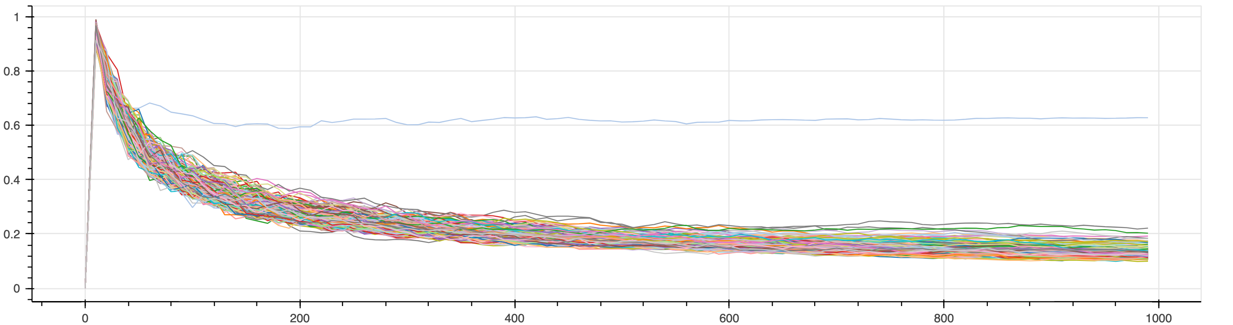
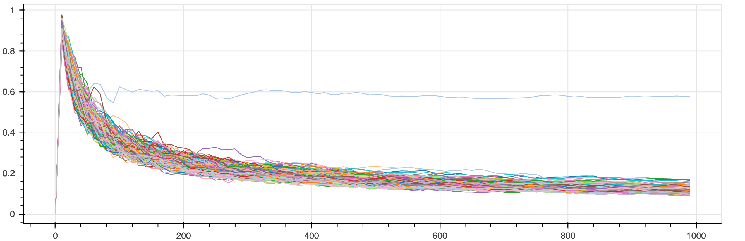
DPA on AES
Power analysis results for 255 different values of the key position 0 obtained for 1000 different traces of the AES encryption implemented in Rust and C
Rust
C
Rust does not provide any additional safety against the side-channel attacks
Key can be read out in less than 100 power traces.

Slide 19
Invasive Attacks
Hardware attacks that require physical manipulations on semiconductors are called invasive attacks. They are very powerful than non invasive attacks but expensive
Reverse Engineering
Microprobing
Laser Attack
For invasive attacks, the assembly code was analysed and some of the secure coding methods were implemented in Rust that helped prevent some prevailing attacks

Slide 20
Secure Coding patterns against invasive attacks
Secure Boolean
All non zero values results in True
255 possibilities to flip a bit and bypass a check
Solution
Instead of True/False, use specific values and these values should have same hamming distance
Make the variable volatile so that secure coding is not replaced
enum SecBool {
SecTrue = 3333,
SecFalse =2222,
SecInit = 1111
}
match unsafe { *core::ptr::read_volatile(&val)}
{
SecBool::SecTrue=> hprintln!("TRUE“),
SecBool::SecFalse =>hprintln!("FALSE),
_ => panic!()
};

Slide 21
Secure Loop
Secure Loop
The iterators of the loop can be modified using the hardware attack or the program counter can be modified leading to interruption of loop or completely skipping of the loop
Solution
To prevent the attack, 2 iterators can be used and checked for their values in and out of the loop
for (i,j) in (0 .. COUNT).zip((0 ..COUNT).rev())
{
if i+j != COUNT
{
sec_reset();
}
//perform critical operations
}

Slide 22
Secure Return parameter
Secure Return parameter
The return value is stored in a register and moved from the register to the variable
The attacker can skip the assembly instruction „bl“.
The previous/random value of r0 moved to this variable
Solution
Passing the value by reference.
Skip the „mov password, r0“ command.
movs r0, #20
bl check_password
mov password, r0
movs r0, sp, #8
bl check_password
In check_password
mov r4, r0 //r0 contains address
movs r0, #5
str r0, [r4]

Slide 23
Secure Branch handling
Program branches can be skipped easily with a physical attack and normal flow execution is continued, leading to skipping of certain checks.
If password == 777
{
//Give admin rights
}
The attacker can flip the output of the compare assembly code to branch to equal even when not equal.
Solution
The comparison should be done again inside the branch to make sure the comparison is still valid and there was no attack
cmp r7, #777
bneq security_alert()
str r4, [sp,10]

Slide 24
Performance Analysis with AES Implementation
AES Algorithm was implemented in safe Rust and this implementation was used for performance evaluation with varying compiler optimization.
Optimization Level
-O0 | No Optimization, fast copilation, most debuggable code
-O1 | Optimization between O0 and O1
-O2 | enables most optimizations
-O3 | may generate larger code to make the program run faster
-Os | Based on O2, Optimization for Size
-Oz | Like –Os but reduces code size further

Slide 25
Clock cycles

Slide 26
NVM Size

Slide 27
Stack Usage

Slide 28
Discussion
 | Security |  | Performance |  |  | Usability
 | Software Attacks | Hardware attacks | Execution Speed | NVM Size | RAM consumption | Inter-portability | Embedded Support | Learning Curve
Rust
C

Slide 29
Conclusion
Prevents memory exploits.
Unsafe -> vulnerabilities, review time.
HW attacks -> secure coding patterns
Similar performance to C
Stack usage (Higher execution speed and NVM size)
O3 better speed at constant NVM size
“Rust is a secure substitute for C for Embedded Software Development”

Slide 30
Future work
Implementing further randomization in the AES algorithm
Analysis of Oz optimization level
Dynamic memory allocation and run-time checks
Using Rust for multi-threaded programming

Slide 31
References
[1] One, Aleph. “Smashing The Stack For Fun And Profit.” (1996).
[2] “The Heartbleed Bug”, https://heartbleed.com/#:~:text=The%20Heartbleed%20Bug%20is%20a,used%20to%.
[3] “Buffer Overread“ https://www.vox.com/2014/6/19/18076318/heartbleed
[4] “CWE Top 25 Dangerous Software Weakness”, https://cwe.mitre.org/top25/archive/2020/2020_cwe_top25.html
[5] ‘The Rust Programming Language’. [Online]. Available: https://doc.rustlang.org/book/. [Accessed: 17-Feb-2016].

Slide 32

Questions?

Slide 33
Extra Slides

Slide 34
Motivation
C for Embedded Systems
Portability
Direct memory access
From Smashing the Stack for Fun and Profit[1] to Heartbleed Vulnerability [2].
Memory exploits in C
Pointer manipulation
No bound checking
Security up to the programmer
The Heartbleed Vulnerability [2]
Example of Buffer overread [3]

Slide 35
Performance Analysis with AES Implementation
AES Algorithm was implemented in safe Rust and this implementation was used for performance evaluation with varying compiler optimization.
Optimization Level | O0, O1, O2, O3, Os, Oz
-O0 | No Optimization, fast copilation, most debuggable code
-O1 | Optimization between O0 and O1
-O2 | enables most optimizations
-O3 | may generate larger code to make the program run faster
-Os | Based on O2, Optimization for Size
-Oz | Like –Os but reduces code size further

Slide 36
Buffer Overread
new_array is located past the length of array a in the memory.
*big_ptr copy the contents of big_ptr to the new_array. So there is an overread by reading the memory past the length of a
Exploited if memory after array a contain some secret, the attacker could retrieve it.
let mut a: [u8; 3] = [2,3,4];
let prt: *mut [u8;3] = &mut a;
let big_ptr: *mut [u8;20] = prt as *mut [u8;20];
unsafe {
let mut new_array: [u8;20] = *big_ptr;
new_array[10] = 10;
}

Slide 37
Secure Loop
Secure Loop
The iterators of the loop can be modified using the hardware attack or the program counter can be modified leading to interruption of loop or completely skipping of the loop
Solution
To prevent the attack, 2 iterators can be used and checked for their values in and out of the loop
for (i,j) in (0 .. COUNT).zip((0 ..COUNT).rev())
{
if i+j != COUNT
{
sec_reset();
}
//perform critical operations
}

